Slide 1


Slide 2
Anything you can do; I can do better... Embracing the SharePoint Framework
Mark Rackley – Chief Strategy Officer – PAIT Group
Julie Turner – Partner – Sympraxis Consulting

Slide 3
Session code
Session information [hidden slide]
Populate your session information here
Anything you can do; I can do better... Embracing the SharePoint Framework Development in SharePoint should be done with the SharePoint Framework, but is it worth it? TypeScript & React are complicated to learn. We've been doing great for years with just JavaScript, why stop now? Join this lively demo packed session & watch Mark Rackley go head-to-head with Julie Turner as Julie tries to convince Mark to embrace the SharePoint Framework. Attendees will learn:
-What's Possible with the SPFx
-The real benefits of the SPFx,TypeScript, & React
-How to transition to the SPFx
SharePoint Conference 2019 https://sharepointna.com/#!/session/Anything%20you%20can%20do,%20I%20can%20do%20better...%20Embracing%20the%20SharePoint%20Framework/3783 5/22/2019 11:30am 318
Mark Rackely, Julie Turner

Slide 4








Mark Rackley
PAITT Group/Chief Strategy Officer
Blogger, Writer, Speaker, Podcaster, Developer, Office 365 MVP
http://www.techsplaining.net
http://.www.collabsummit.org
http://www.markrackley.net/
https://www.linkedin.com/in/markrackley​
@mrackley
https://slideshare.net/mrackley https://github.com/mrackley
Julie Turner
Sympraxis Consulting/Partner
Professional developer since 1995
Working with SharePoint since 2007
Microsoft MVP, Office Servers and Services since 2017
https://julieturner.net
https://www.linkedin.com/in/juliemturner ​
@jfj1997
http://bit.ly/julieturnerslides
https://github.com/juliemturner/Public-Samples

Slide 5
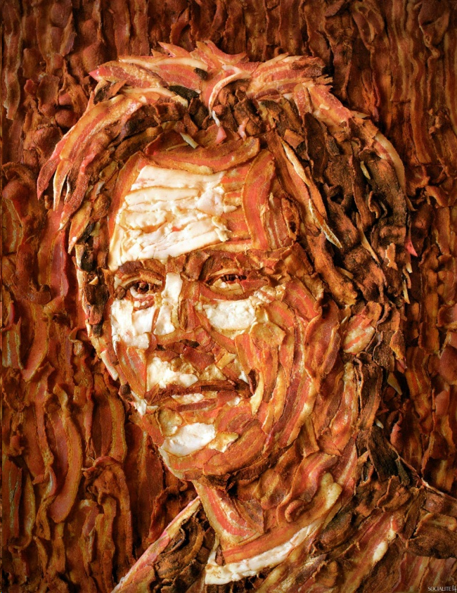

WHY?!
Open and honest discussion about the pro’s and con’s of moving to the SharePoint Framework.
Classic development methods
Getting started with SPFx, using JavaScript
Moving further, using TypeScript, fluent libraries, and frameworks
Deployment
@mrackley @JFJ1997 #SPC19
Notes:
Image: https://v1.escapistmagazine.com/articles/view/features/galleryoftheday/10614-Crazy-Bacon-Creations.8

Slide 6
Classic SharePoint – Overview
Content Editor (CEWP) or Script Editor (SEWP) Web Parts
Files stored in a document library or CDN
Can easily edit scripts in SPO Text Editor of VS Code
Create applications or manipulate the DOM
Use Rest, CSOM, or SPServices to interact with SharePoint sites, lists, libraries, and users
Works the same in SharePoint 2007, 2010, 2013, 2016, 2019, and SPO (classic mode)
@mrackley @JFJ1997 #SPC19

Slide 7
Classic CEWP
Demo tagline or details
@mrackley @JFJ1997 #SPC19

Slide 8
Classic SharePoint – Pros and Cons
Pros
Extremely fast and easy to create a solution
Any user who can edit a page and has rights can create a solution
Extremely low skill threshold
Tons of free JavaScript and jQuery libraries to leverage
Cons
Any user with edit rights can mess with the source code
Management and deployment story for code is weak (not enterprise ready)
Web Part property editing experience
Cannot deploy to modern pages
Teams deployment
Isolated web parts
@mrackley @JFJ1997 #SPC19

Slide 9
Where Should I Put My Stuff?
 | Widgets in one Site Collection | Widget in one tenant/farm, multiple site collections | Widgets used across multiple tenants/farms*
Deploy to site collection app catalog | ✓ | X | X
Deploy to tenant app catalog | ✓ | ✓ | X
Deploy to CDN (Azure, AWS, dedicated server, other commercial CDN provider…)** | O | O | ✓
- Good solution O – Optional solution, potentially overkill X – Not a viable/good choice
* - Not referencing any code that would be part of a commercial solution.
** - CDNs or Content Delivery Networks allow “content” to be made highly available to end users everywhere.
@mrackley @JFJ1997 #SPC19
Notes:
BG

Slide 10
SharePoint Framework – Overview
Open source, but 100% Microsoft backed “framework”.
Used by 1st party to build modern experiences.
Framework independent*
IDE independent
Provides development framework that allows you to bundle and deploy your code and then centrally manage it
Utilizes modern web development tooling (Node/NPM, Gulp, TypeScript, Webpack, Yoman)
Works on Classic and Modern
Work on SharePoint Mobile Application
@mrackley @JFJ1997 #SPC19

Slide 11
Convert to SPFx
Demo tagline or details
@mrackley @JFJ1997 #SPC19

Slide 12
JavaScript SPFx – Pros and Cons
Pros
Get’s you into modern but allows you to reuse code
Use Web Part Properties instead of editing script
Works on Classic and Modern
Repeatable process to upgrade existing solutions
Cons
Lots of room for simple errors to catch you
Multiple web parts on a page
More work needed to make REST calls to SharePoint - SPHttpClient
No good way to access the Microsoft Graph - GraphHttpClient
Ability to streamline code for length and simplicity
@mrackley @JFJ1997 #SPC19

Slide 13

What is Typescript?
Typescript is a superset of JavaScript and is “transpiled” into regular JavaScript.
Static type checking catches errors earlier
Intellisense
Use ES6 features in ES3, ES5 (or at least get compatibility checking)
Class structure familiar to .NET programmers
@mrackley @JFJ1997 #SPC19
Notes:
JT

Slide 14
How many mistakes can you find?
(function () { function loadMe() {
var greetings = ["Happy", "Have a good", "It's"]; var weekdays = ["Sunday", "Monday", "Tuesday", "Wednesday", "Thursday", "Friday", "Saturday"];
var greeting = greetings[Math.floor(Math.random * greetings.length)]; var todayIs = weekdays[Date().getDay()];
document.getElementByID('elt1').innerHTML = greeting + " " + todayIs + "!"; }
window.onload = loadMe(); })()
@mrackley @JFJ1997 #SPC19
Notes:
JT

Slide 15
How many mistakes can you find?
(function () { function loadMe() {
var greetings = ["Happy", "Have a good", "It's"]; var weekdays = ["Sunday", "Monday", "Tuesday", "Wednesday", "Thursday", "Friday", "Saturday"];
var greeting = greetings[Math.floor(Math.random() * greetings.length)]; var todayIs = weekdays[new Date().getDay()];
document.getElementByIDd('elt1').innerHTML = greeting + " " + todayIs + "!"; }
window.onload = loadMe(); })()
@mrackley @JFJ1997 #SPC19
Notes:
JT
Invoke, don’t reference, random()
Date() returns a string, you need new Date()
Correct capitalization in getElementById
Pass reference to loadMe, don’t invoke it

Slide 16
(1) Type Annotations
Intrinsics
var myString: string = '<u>Results</u><br />';
var myNum : number = 123;
var myAny : any = "Hello";
myString = <number>myAny;
var myDate: Date = new Date;
var myElement: HTMLElement = document.getElementsByTagName('body')[0];
var myFunc : (x:number) => number =
function(x:number) : number { return x+1; }
var myPeople: {firstName: string, lastName: string}[] =
[
{ firstName: “Alice", lastName: “Grapes" },
{ firstName: “Bob", lastName: “German" }
]
Any and Casting
Built-in objects
Functions
Complex Types
@mrackley @JFJ1997 #SPC19
Notes:
JT

Slide 17
(2) ES6 Compatibility
var myFunc : (nx:number) => number =
(n:number) => {
return n+1;
}
let x:number = 1;
if (true) { let x:number = 100; }
if (x === 1) { alert ('It worked!') }
var target: string = ‘world’;
var greeting: string = `Hello, ${target}`;
“Fat Arrow” function syntax
Block scoped variables
Template strings
@mrackley @JFJ1997 #SPC19
Notes:
JT

Slide 18
(3) Classes and Interfaces
Interface
interface IPerson {
getName(): string;
}
class Person implements IPerson {
private firstName: string;
private lastName: string;
constructor (firstName: string, lastName:string) {
this.firstName = firstName;
this.lastName = lastName;
}
getName() { return this.firstName + " " + this.lastName; }
}
var me: IPerson = new Person("Bob", "German");
var result = me.getName();
Class
Usage
@mrackley @JFJ1997 #SPC19
Notes:
JT

Slide 19
PnPJS
Work for both TypeScript and JavaScript projects
Work seamlessly with SPFx projects but can also work with plain JS solutions
@pnp/
 | common | Provides shared functionality across all pnp libraries
 | config-store | Provides a way to manage configuration within your application
 | graph | Provides a fluent api for working with Microsoft Graph
 | logging | Light-weight, subscribable logging framework
 | nodejs | Provides functionality enabling the @pnp libraries within nodejs
 | odata | Provides shared odata functionality and base classes
 | pnpjs | Rollup library of core functionality (mimics sp-pnp-js)
 | sp | Provides a fluent api for working with SharePoint REST
 | sp-addinhelpers | Provides functionality for working within SharePoint add-ins
 | sp-clientsvc | This library provides base classes for working with the legacy SharePoint
 | sp-taxonomy | Provides a fluent api for working with SharePoint Managed Metadata
@mrackley @JFJ1997 #SPC19

Slide 20
Async/Await
Introduced support in TypeScript in version 1.7 (released 3 years ago)
Support for JavaScript in ES8 (ES2017)
@mrackley @JFJ1997 #SPC19
Notes:
https://caniuse.com/#feat=async-functions
https://www.typescriptlang.org/docs/handbook/release-notes/typescript-1-7.html
https://caniuse.com/#feat=es6-generators

Slide 21
SPFx with Typescript/PnPJS
Demo tagline or details
@mrackley @JFJ1997 #SPC19

Slide 22
SharePoint Framework modern tools – Pros and Cons
Pros
Lots of room for simple errors to catch you
Multiple web parts on a page
Utilize SPHttpClient to make REST calls easier (or use fluent PnPJS)
Utilize GraphHttpClient to access the Microsoft Graph (or use fluent PnPJS)
Ability to streamline code for length and simplicity (async/await vs promises)
Cons
Learning curve for TypeScript
Frameworks like Angular Elements and React have big learning curve
@mrackley @JFJ1997 #SPC19

Slide 23
Deployment – Pros and Cons
Governance
Ability for Admins to create site collection app catalog to silo solutions.
@mrackley @JFJ1997 #SPC19

Slide 24
Action plan
Calls to action
What should attendees do when they return to the office?
How can they put what they learned to use?
Use this layout for 3 CTAs or 4-photo layout for 4 CTAs
Insert icons or screenshots in photo blocks. Center over text.
Call to action [Level 1]
Description or steps [Level 2]
Call to action [Level 1]
Description or steps [Level 2]
Call to action [Level 1]
Description or steps [Level 2]

Slide 25

Thank you
Thank you and resources
This slide will animate and advance automatically to the next slide [Thank you & resources] where you can conclude.
Do not change this slide. DO delete this note.

Slide 26
Thank you
Final slide
Leave this up while you answer questions.
People will take photos of this slide, so it should have readable and actionable leave-behinds.
Questions
CTAs Repeat CTAs from ACTION PLAN slide.
Insert a column for 4 CTAs.
Call to action #1 | Call to action #2 | Call to action #3
aka.ms/SPC/Sessions/<code> | Share slides and resources from this session
aka.ms/SPC/Sessions/<product> | Learn more from related sessions at SPC19
aka.ms/<product>/Resources | Explore resources for deployment and adoption
aka.ms/<product>/Blog | Stay up to date on the latest product news
aka.ms/<product>/Blog/SPC19 | Review the news and announcements from SPC19
aka.ms/<product>/Community | Join the conversation in the Microsoft Technical Community
aka.ms/<product>/Feedback | Give us feedback and input to shape the future
aka.ms/M365Roadmap | Discover what’s coming with the Microsoft 365 Roadmap
@<speaker> #SPC19 | Follow me and share this session
Resources
Try to stick as closely as possible to this list of resources, but delete or modify rows where necessary.
If you have a lot of resources, create a resource page and point to it with aka.ms/SPC19/Sessions/<Session Code>.
PMMs own getting the resources online with AKAs.

Slide 28
Template and slide resources
Use these slides as guidance, then delete this section from the final deck

Slide 29
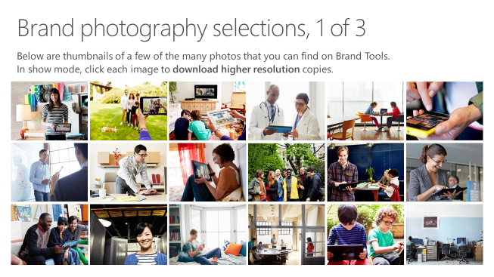
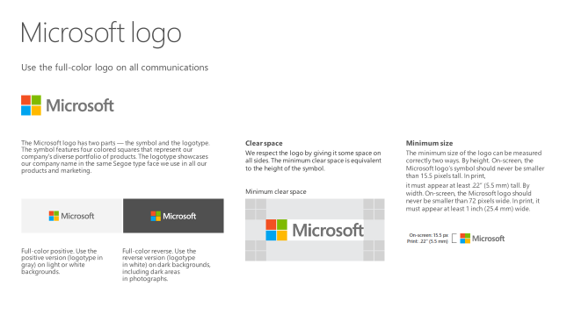
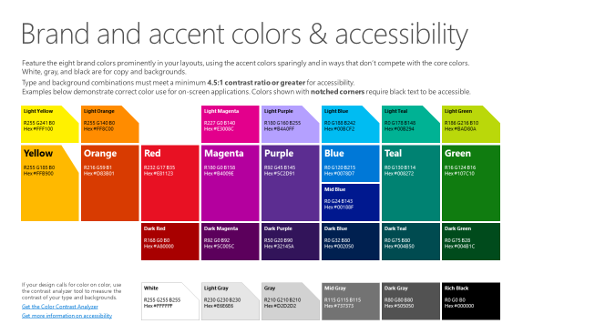
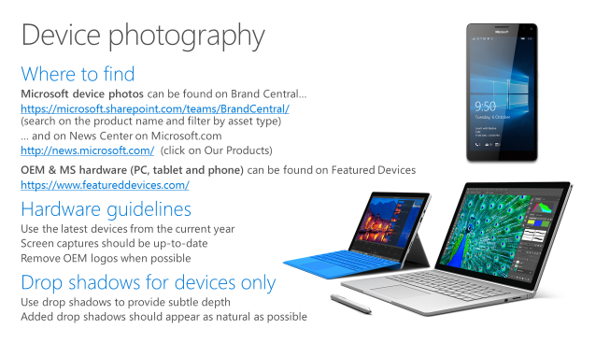
Microsoft brand guidelines
Looking for more slide resources?
Brand guidelines for PowerPoint templates is a separate slide deck that provides an overview of the Microsoft brand, guidelines, resources, tips and much more.
A few of the slides are shown at right.
Download from: https://microsoft.sharepoint.com/teams/BrandCentral/Pages/Presentations.aspx

Slide 30
Using layouts

Slide 31
Preferred text layout (no bullets)
Main topic 1: size 40pt
Size 20pt for the subtopics
Size 20pt for the subtopics
Need a subtitle on the slide?
CTRL+ENTER starts a new line
Set font to SEGOE UI SEMIBOLD or SEGOE UI and reduce font size Move top of content placeholder (slide text) down to align with bottom of slide title placeholder
Reminders
Set the slide title to “Sentence case”
Set subheads to “Sentence case”
Hyperlink style
www.microsoft.com

Slide 32
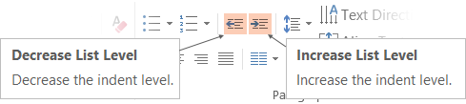
Adjusting list levels
Main topic 1: size 40pt
Size 20pt for the subtopics
Size 20pt for the subtopics
Main topic 2: size 40pt
Size 20pt for the subtopics
Size 20pt for the subtopics
Main topic 3: size 40pt
Size 20pt for the subtopics
Size 20pt for the subtopics
Use the “Decrease List Level” and “Increase List Level” tools on the Home Menu to change text levels.
Try this:
Place your cursor in any row of text to the left that says “Size 20pt for subtopics”
Next click the Home tab, and then on the “Decrease List level” tool. Notice how the line moves up one level.
Now try placing your cursor in one of the “Main topic…” lines of text. Click the “Increase List Level” tool and see how the text is pushed in one level
Use these 2 tools to adjust your text levels as you work

Slide 33
Working with color

Slide 34
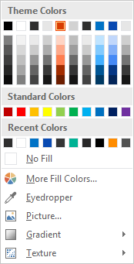
Slide palette info
The PowerPoint palette for this template has been built for you and is shown below. Avoid using too many colors in your presentation.
Accent colors 1-6 – (6 Theme Colors to the far right)
Accent 1
Accent 2
Accent 3
Accent 4
Accent 5
Accent 6
Use Accent 1 as the main accent color. Use Accent 2 and Accent 3 when additional colors are needed.
Accent 4 is the product color for SharePoint and Yammer. Accent 5 is the product color for OneDrive. Do not use both on the same slide.

Slide 35
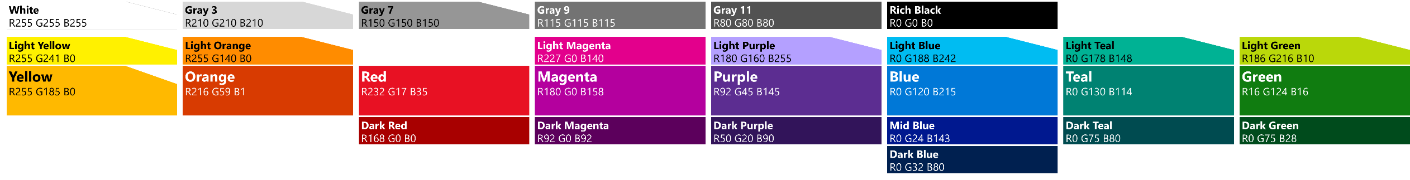
Color palette
Use these colors as accents in graphic elements
Copy and paste the palette to a slide where you first need the color.
Select a shape or text requiring the color.
Click Shape Fill, Shape Outline, or Font Color.
EITHER Click the eyedropper and select the color OR click More Colors and, on the Custom tab, enter the Red Green Blue values shown.
The next time you need the color, it will be in the “recently used color” portion of the palette.

Slide 36
Formatting and aligning

Slide 37
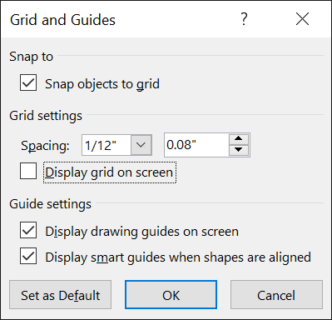
Guides
Guides in PowerPoint
Guides in PowerPoint help you align elements on slides. You can configure PPT to “snap to” guides, making positioning easy. Guides are particularly useful when creating slides with visual elements, multiple columns, shapes, etc. They’re not as useful if all you’re doing is text slides.
Make use of guides
Right-click outside this slide and click Grids and Gridlines.
Set the options as shown. Optionally select to display grid as well.
Hide guides
Click the View tab to hide (or show) guides.

Slide 38
Final scrubbing of a deck

Slide 39
Tips for finalizing a deck
Turn off guides (orange dotted lines): VIEW tab.
Scrub for hidden information on slide.
Save the file (just in case!)
Click File.
Click Inspect for Issues then click Check Document.
Select the items you want removed from the deck.
IMPORTANT: At the bottom of the list is “Presenters Notes”. Consider whether you want notes removed or not
Click Inspect.
Continue as prompted.
Set author, title, and other file information.
Click File.
On the Info page, enter author, title, and other properties.
Last step: sanity-check and troubleshoot file size (next slide).

Slide 40
Making PPTX file size friendly
Delete unneeded slide masters & layouts
Microsoft presentations often end up bloated with multiple masters, many of which have far too many photos on slide layouts that are never used in the presentation, leading to unnecessary bloat.
Click View—Slide Master.
Delete slide layouts and masters, particularly those with photos, logos & screenshots which contribute most to file size bloat.
If a slide layout or master won’t let you delete it, it’s in use in the presentation. Hover over the item and it will tell you what slide it is used on. Consider re-assigning the layout of the slide in question. Back in normal view, right-click the slide and choose another layout. This will help you ‘consolidate’ the layouts in use and, hopefully, give you the opportunity to delete more unneeded layouts and masters.
Compress pictures
1. Select any image or photo.
2. On the Picture Tools tab, click Compress Pictures.
3. Clear the “Apply only to this picture” checkbox.
4. Select the “Delete cropped areas of pictures” checkbox.
5. Select the Print or Web radio button.
6. Click OK.
7. Save.
You might have to use Save As to fully compress the presentation. Check file size with all slides deleted and repeat to troubleshoot.

Slide 41
Guide to inserting or ‘merging’ slides into another template

Slide 42
Preparing to insert slides into the template
Consider layouts in originating slide master
“Merging” slides into a new template is best achieved when the layout names in the originating master (your ‘source’ deck) match the layout names in the destination master (this template’s master).
If your originating deck has a bunch of slides with a ‘different’ title than the appropriate layouts in this deck, you can save yourself a bunch of work by renaming the layouts in the originating deck to match the name of the layout in this master.
Identify the name of the layout in this master: Right-click any slide, point to LAYOUT, then look at the name of the layouts. Some layout names are longer than what’s shown in the gallery—hover over the desired layout to see its full name in the ‘tool tip’.
In your source deck, switch to SLIDE MASTER view.
Right-click the source layout, choose RENAME, and enter the name as it is in this master.

Slide 43
Insert slides into the template
Paste using destination formatting
When you paste slides into this presentation, the default is to use destination formatting, rather than source formatting. This is generally the best option.
Re-map slide layouts
If your originating deck has layouts with unique names, those layouts will be ‘merged in’ to this deck, which is likely not ideal. Right-click offending slides and choose LAYOUT. Your (likely ‘offending’) layouts will be at the end of the gallery of layouts—they are appended to the master. Pick one of the ‘real’ layouts in this template.

Slide 44
Confirm optimal merge
Check whether you brought any ‘junk’ in with you
Ideally, after you’ve inserted slides from another deck, you should not have inserted any additional slide masters or layouts.
Switch to Slide Master view
In the first master, you should not see any layouts that start with #_ (e.g. 1_) and you should not see any layouts that aren’t in a fresh, new presentation created with the template.
You should also not see any additional slide masters (shown as a ‘root’ of the tree in slide master view).
If you do see ‘additions’ to the master or layouts, you can hover over those items to see which slides brought them in and are using them. You can then change the layout on those slides to one of the standards. After a layout or master is no longer being ‘used’, you can delete it in the Slide Master view.

Slide 45
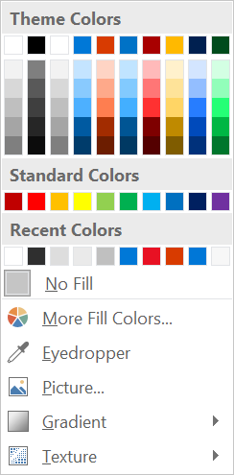
Working with colors
Understanding color schemes
Color schemes in a PowerPoint slide master associate “named color scheme elements” like “Accent 1” with a specific color. Problems can occur when you move objects between masters with different schemes. An object that looks “blue” in one master may become “red” in another master. That’s because the object wasn’t actually filled with “blue”—it was filled with “Accent 1” (for example) in the source template, and “Accent 1” was defined as “red” in the target template.
Using colors correctly in PowerPoint
When you want an object to ‘adjust’ to its template/master, you should use a ‘theme color’ from the color scheme. But more often, you want an object to be a specific color—you want a “red light” for example. In these situations you should always pick from the bottom part of the color palette.
Scheme Colors are dynamic—defined by the master. Objects using these colors will adjust as they are moved between masters
These are ‘fixed’ colors and should be used when you want a specific color for an object

Slide 46
Dealing with undesirable color remapping
Understanding color remapping
When you move slides between templates/masters, objects that are formatted with theme colors from the color scheme will adjust to the new master. If those objects were meant to keep a specific color—e.g. a “red light”—you’ve seen the effect of incorrect color formatting. You have two choices for how to deal with this: Format the object correctly, or as a ‘hack’, change the color scheme.
Format the object correctly
To format the object correctly, e.g. to make the ‘red light’ red again, right-click it, choose FORMAT SHAPE and, on the FILL tab, select the correct color from the bottom part of the color palette. Do not use a theme color.

